Slide 1



Natural Language as Input for and Output from Visualization Systems
Arjun Srinivasan
@10_arjun
Tableau Research
Notes:
Good afternoon everyone, I’m Arjun Srinivasan and I’m a member of the research staff at Tableau.
I joined Tableau about a year ago and before that I was a PhD student at Georgia Tech.
So for this lighting talk, I’ll cover a few projects that I worked on during my PhD as well as some more recent work at Tableau.

Slide 2





Natural Language
Visualizations
Humans
Visualization Systems
Notes:
At a high-level, I’m interested in interaction-focused research in the context of visualization tools, and over the past few years, I’ve specifically explored how natural language can be used as both an input modality for people to express their goals to a system, as well as an output modality for systems to guide people.

Slide 3
Natural Language Input
Visualizations
Humans
Visualization Systems
Notes:
In the space of using language as an input modalitiy,

Slide 4
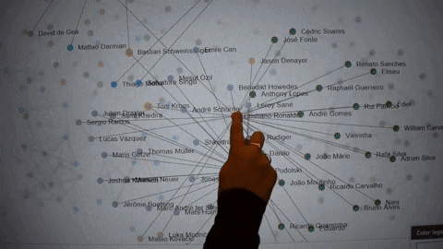
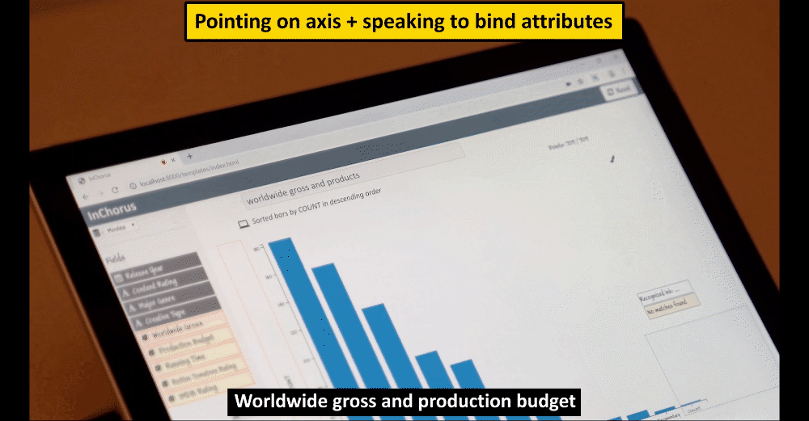
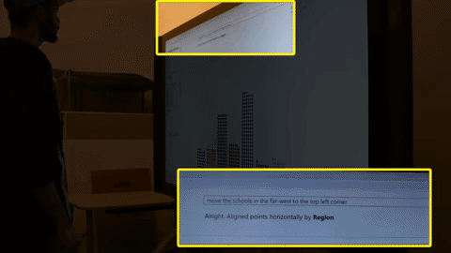
Natural Language as Input for Visualization Systems: Designing Fluid Interaction Experiences
IEEE VIS 2017
ACM CHI 2020
IEEE TVCG 2020
Notes:
One main theme of my work has been to explore how we can design multimodal interfaces that leverage speech in combination with other modalities like pen and touch to facilitate a more fluid and expressive interaction experience.
And here you can see some examples of these multimodal visualization systems working across a range of charts and devices.

Slide 5
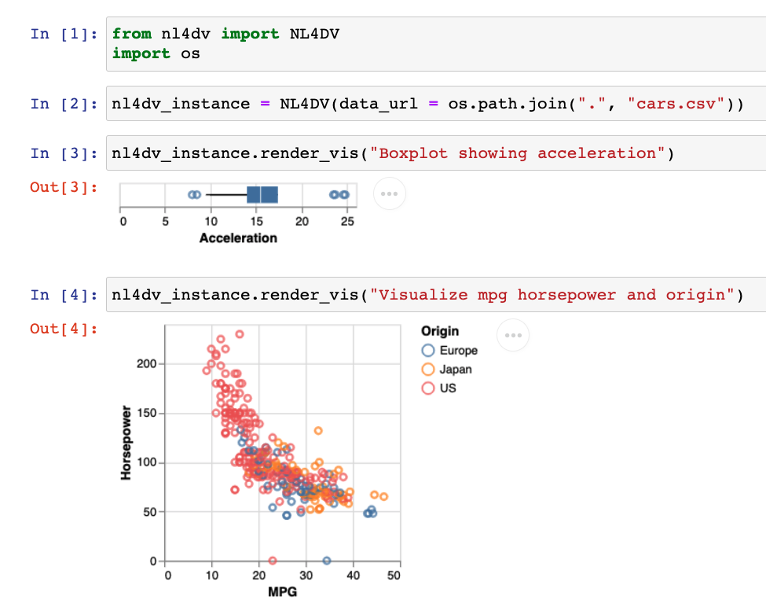
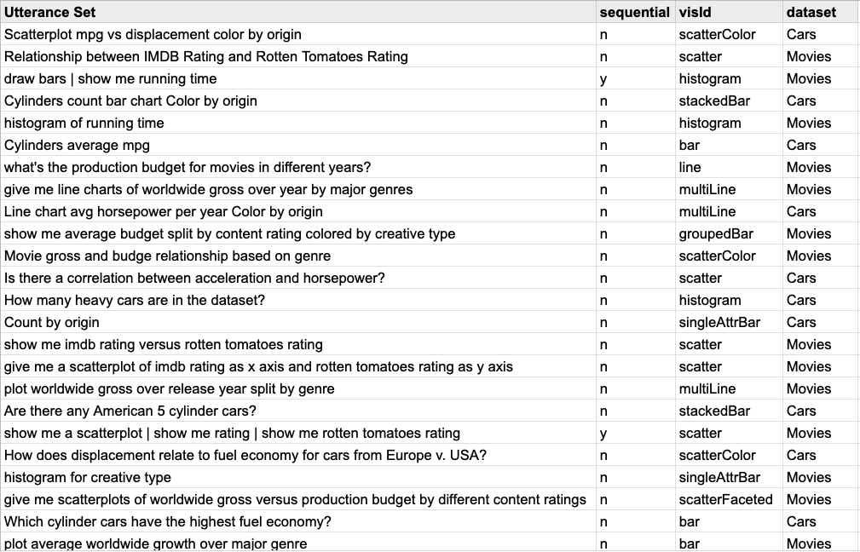


Natural Language as Input for Visualization Systems: Developer Resources
nl4dv.github.io
nlvcorpus.github.io
IEEE VIS 2020
ACM CHI 2021
Notes:
Besides working on these systems myself, I’ve also built toolkits and datasets that can help other developers experiment with natural language input and prototype new systems of their own.

Slide 6
Visualizations
Natural Language Output
Humans
Visualization Systems
Notes:
Switching gears to thinking about language as output from visualization tools,

Slide 7
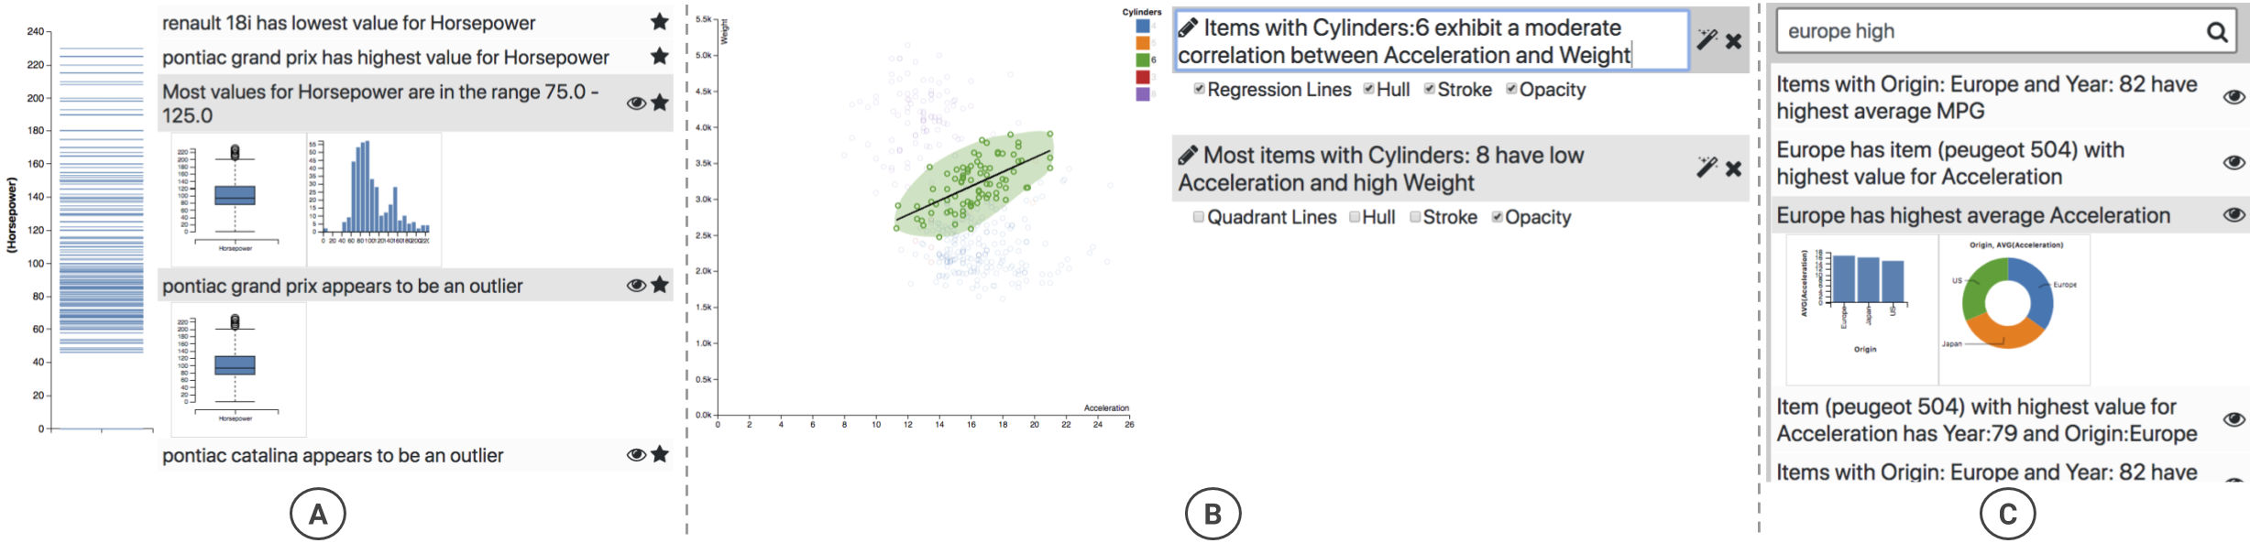
Natural Language as Output from Visualization Systems: Recommendations to guide analysis and communication
Augmenting Visualizations with Interactive “Data Facts”, IEEE VIS 2018
Notes:
I’ve worked on a couple of systems that generate text to guide visual analysis and communication.
For instance, I’ve looked into how visualization systems can use some basic statistics to infer textual “data facts” and leverage those as a way to offer visualization or annotation recommendations that can aid data-driven communication.

Slide 8
Natural Language as Output from Visualization Systems: Recommendations to guide analysis and communication
Utterance Recommendations for Conversational Visual Analysis, ACM UIST 2021
Notes:
In more recent work that we presented at UIST a couple of weeks ago, we also looked into how visualization systems can generate utterance recommendations and present these at different points during a session to guide analysis while implicitly aiding discoverability of language input, which has been a long standing challenge in HCI.

Slide 9



Humans
Visualization Systems
Notes:
While I’ve mainly talked about natural language interfaces today, I’m happy to chat about interaction research in the context of visualization tools in general,

Slide 10





Can we leverage NL in data-driven communication tools? What are the opportunities and challenges?
What are the challenges and potential tasks for curating large-scale (NL+VIS) datasets?
What type of data facts do people care about? When and how should these be presented? What are the risks/benefits of “auto-insight” systems?
How can we leverage NL, audio, and/or other modalities to improve accessibility?
Humans
Visualization Systems
Notes:
But just to get some conversations going, I’ve also listed out some specific topics and questions that I’m currently most excited about.
So if you’re interested in thinking about
the role of language in data-driven communication,
Have ideas about curating large scale natural language datasets
Want to think about how we can build safer and more functional “auto-insight” systems
Or how we can leverage natural language and other modalities to make visualizations more accessible,
Let’s chat more!

Slide 11
Thank You
Arjun Srinivasan
Tableau Research
Can we leverage NL in data-driven communication tools? What are the opportunities and challenges?
What are the challenges and potential tasks for curating large-scale (NL+VIS) datasets?
What type of data facts do people care about? When and how should these be presented? What are the risks/benefits of “auto-insight” systems?
How can we leverage NL, audio, and/or other modalities to improve accessibility?
Humans
Visualization Systems
Notes:
Thank you and I’ll be happy to take any questions.

